Slide 1


MONTHLY RETAIL SALES SUMMARY REPORT TEMPLATE
Use the Monthly Retail Sales Summary Report Template in Excel to enter data that will populate the charts and graphs. Place screenshots of each element on the following slides to build out your Monthly Retail Sales Summary Report Presentation.
MONTHLY RETAIL SALES SUMMARY PRESENTATION

Slide 2
REPORTING PERIOD
DATE
00/00/00 – 00/00/00
MONTHLY RETAIL SALES SUMMARY PRESENTATION

Slide 3
TABLE OF CONTENTS
1
2
3
4
Summary Report
Total Monthly Sales Amounts
Sales by Product
Previous Month Comparison
MONTHLY RETAIL SALES SUMMARY PRESENTATION | TABLE OF CONTENTS
PROJECT REPORT

Slide 4
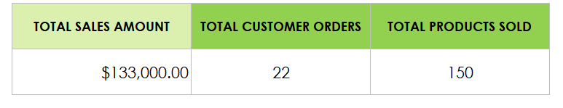
1. SUMMARY REPORT
PROJECT REPORT
SUMMARY REPORT

Slide 5
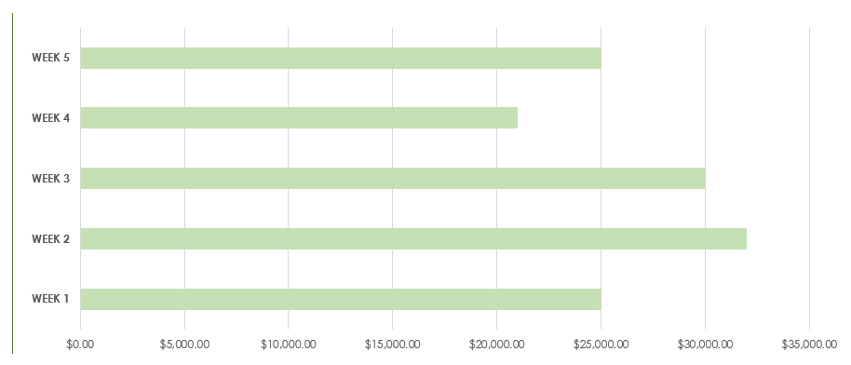
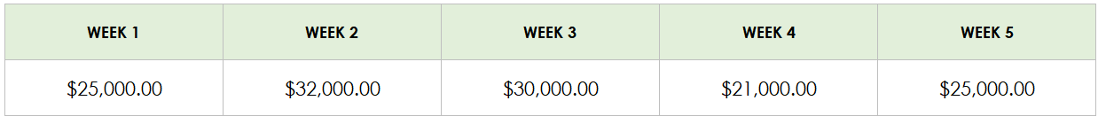
2. TOTAL MONTHLY SALES AMOUNTS
PROJECT REPORT
TOTAL MONTHLY SALES AMOUNTS

Slide 6
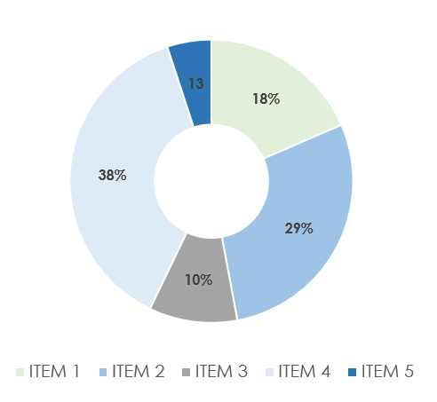
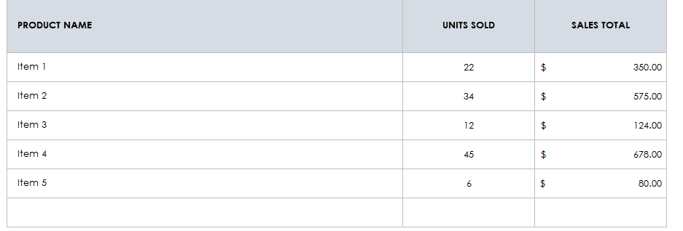
3. SALES BY PRODUCT
PROJECT REPORT
SALES BY PRODUCT

Slide 7
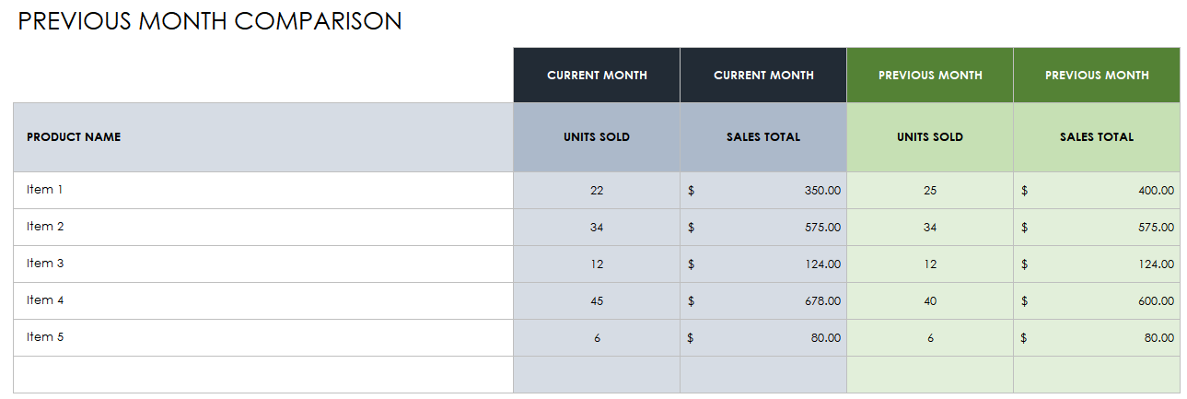
4. PREVIOUS MONTH COMPARISON
PROJECT REPORT
PREVIOUS MONTH COMPARISON

Slide 8
DISCLAIMER Any articles, templates, or information provided by Smartsheet on the website are for reference only. While we strive to keep the information up to date and correct, we make no representations or warranties of any kind, express or implied, about the completeness, accuracy, reliability, suitability, or availability with respect to the website or the information, articles, templates, or related graphics contained on the website. Any reliance you place on such information is therefore strictly at your own risk.

