Slide 1

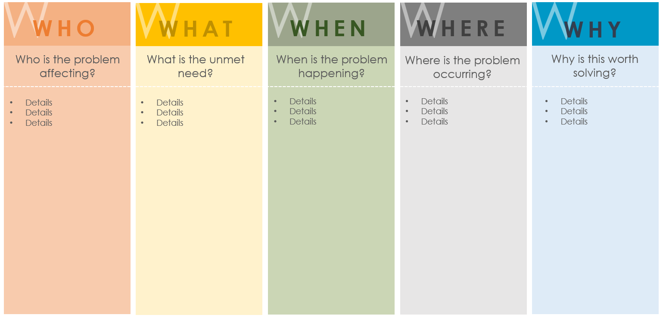
5 Ws PRODUCT PROBLEM STATEMENT SLIDE TEMPLATE
CREATED BY
NAME
Date Created: MM/DD/YY

Slide 2
PROBLEM STATEMENT: Enter the problem statement here …
W
W
W
W
W
WHO
WHAT
WHEN
WHERE
WHY
Who is the problem affecting?
What is the unmet need?
When is the problem happening?
Where is the problem occurring?
Why is this worth solving?
Details
Details
Details
Details
Details
Details
Details
Details
Details
Details
Details
Details
Details
Details
Details

Slide 3
DISCLAIMER Any articles, templates, or information provided by Smartsheet on the website are for reference only. While we strive to keep the information up to date and correct, we make no representations or warranties of any kind, express or implied, about the completeness, accuracy, reliability, suitability, or availability with respect to the website or the information, articles, templates, or related graphics contained on the website. Any reliance you place on such information is therefore strictly at your own risk.

