Slide 1
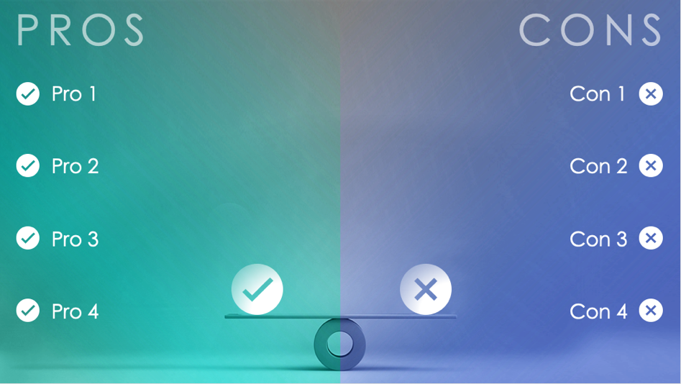
PROS AND CONS SEESAW SLIDE TEMPLATE
When to Use This Template:
Use this template to facilitate decision-making discussions or enhance a presentation slide deck.
Notable Template Features:
Using a visual tool to illustrate the pros and cons of a strategy, decision, or product gives viewers an immediate understanding of positive and negative points. This slide template uses color to highlight pros and cons, and the seesaw in the center suggests a weighing of both sides.

Slide 2
PROS
CONS
Pro 1
Con 1
Pro 2
Con 2
Pro 3
Con 3
Pro 4
Con 4

Slide 3
DISCLAIMER Any articles, templates, or information provided by Smartsheet on the website are for reference only. While we strive to keep the information up to date and correct, we make no representations or warranties of any kind, express or implied, about the completeness, accuracy, reliability, suitability, or availability with respect to the website or the information, articles, templates, or related graphics contained on the website. Any reliance you place on such information is therefore strictly at your own risk.

