Slide 1
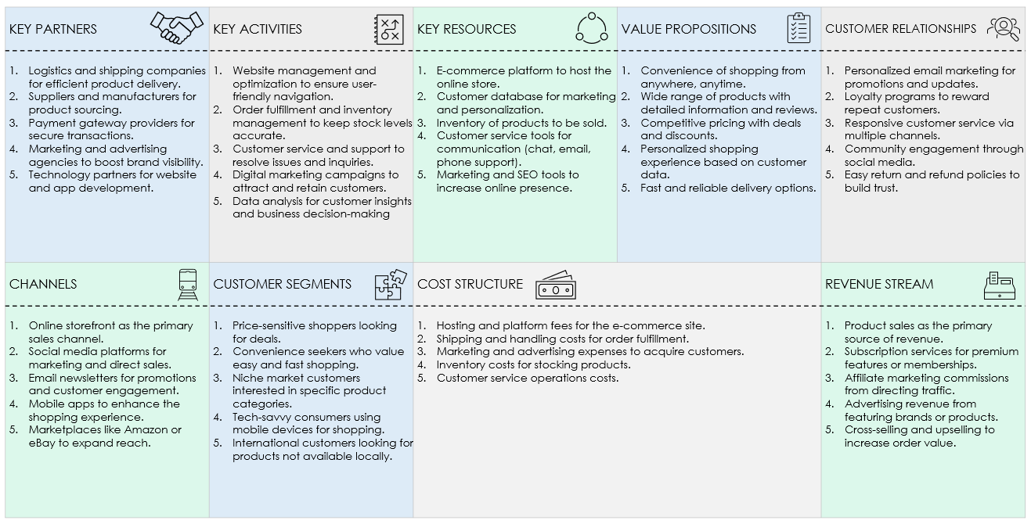
E-COMMERCE BUSINESS MODEL CANVAS TEMPLATE for PowerPoint
The following slide provides a comprehensive overview of an e-commerce business model, highlighting key considerations for each section.

Slide 2
E-COMMERCE BUSINESS MODEL CANVAS TEMPLATE
KEY PARTNERS | KEY ACTIVITIES | KEY RESOURCES | VALUE PROPOSITIONS | CUSTOMER RELATIONSHIPS
Description | Description | Description | Description. | Description
CHANNELS | CUSTOMER SEGMENTS | COST STRUCTURE |  | REVENUE STREAM
Description | Description | Description |  | Description

Slide 3
DISCLAIMER Any articles, templates, or information provided by Smartsheet on the website are for reference only. While we strive to keep the information up to date and correct, we make no representations or warranties of any kind, express or implied, about the completeness, accuracy, reliability, suitability, or availability with respect to the website or the information, articles, templates, or related graphics contained on the website. Any reliance you place on such information is therefore strictly at your own risk.

