Slide 1

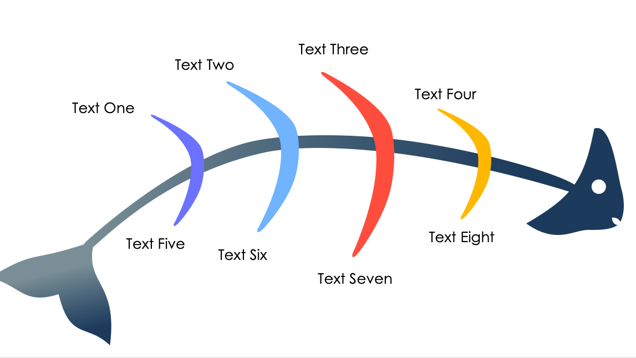
PowerPoint Simple Fishbone Diagram Template
When to Use This Template: Choose this fishbone design when you want to deliver a clear and impactful presentation of the causes of an issue. Using minimal text, highlight the factors contributing to business or educational scenarios, performance obstacles, or operational inefficiencies.
Notable Template Features: This diagram is streamlined to facilitate a clear, focused delivery, allowing presenters to emphasize key points. Each segment of the fishbone naturally draws the eye and directs attention to the written content. This enables viewers to quickly grasp important information and the relationship between different elements.

Slide 2
PowerPoint Simple Fishbone Diagram Template
Text Three
Text Two
Text Four
Text One
Text Five
Text Eight
Text Six
Text Seven

Slide 3
DISCLAIMER Any articles, templates, or information provided by Smartsheet on the website are for reference only. While we strive to keep the information up to date and correct, we make no representations or warranties of any kind, express or implied, about the completeness, accuracy, reliability, suitability, or availability with respect to the website or the information, articles, templates, or related graphics contained on the website. Any reliance you place on such information is therefore strictly at your own risk.

