Slide 1

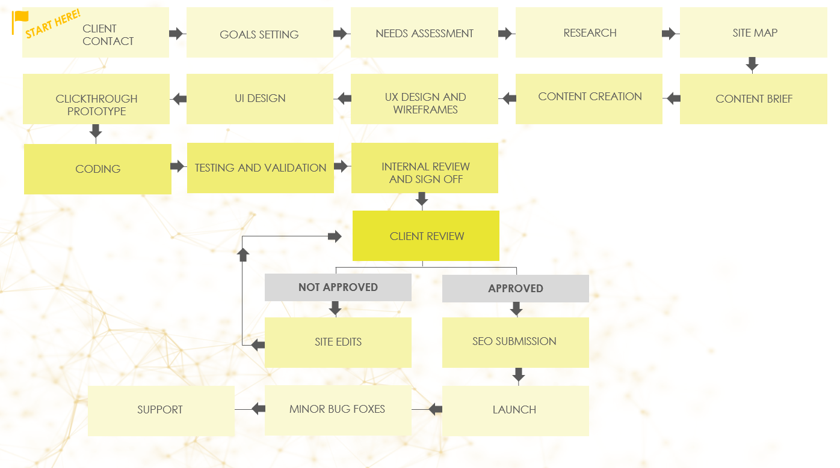
WEB DEVELOPMENT PROCESS
WORKFLOW

Slide 2


START HERE!
CLIENT CONTACT
GOALS SETTING
NEEDS ASSESSMENT
RESEARCH
SITE MAP
CLICKTHROUGH PROTOTYPE
UI DESIGN
UX DESIGN AND WIREFRAMES
CONTENT CREATION
CONTENT BRIEF
CODING
TESTING AND VALIDATION
INTERNAL REVIEW
AND SIGN OFF
CLIENT REVIEW
NOT APPROVED
APPROVED
SITE EDITS
SEO SUBMISSION
SUPPORT
MINOR BUG FOXES
LAUNCH

Slide 3
DISCLAIMER Any articles, templates, or information provided by Smartsheet on the website are for reference only. While we strive to keep the information up to date and correct, we make no representations or warranties of any kind, express or implied, about the completeness, accuracy, reliability, suitability, or availability with respect to the website or the information, articles, templates, or related graphics contained on the website. Any reliance you place on such information is therefore strictly at your own risk.

