Slide 1

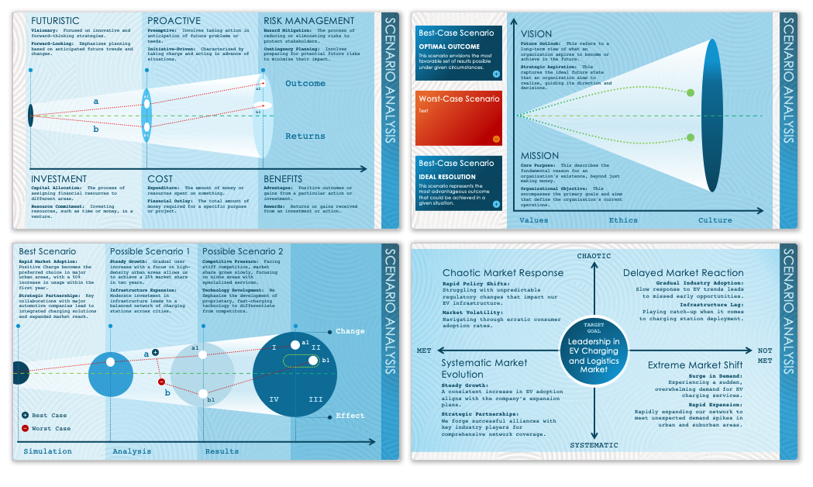
Example Business Analysis Scenario Template
When to Use This Template: Employ this business analysis scenario template with or without sample data to present a detailed assessment of complex business scenarios, such as shifts in market dynamics or competitive landscapes, to your team or stakeholders. It's particularly useful for business analysts and corporate strategists who need to convey business environment analyses during strategic planning meetings or executive briefings.
Notable Template Features: This template features comprehensive slide layouts that facilitate a clear, thorough exploration of various business scenarios. Its standout attributes include dedicated sections for detailing market trends, competitive analysis, and strategic implications, complemented by engaging visual elements.

Slide 2

FUTURISTIC
PROACTIVE
RISK MANAGEMENT
Visionary: Focused on innovative and forward-thinking strategies.
Forward-Looking: Emphasizes planning based on anticipated future trends and changes.
Preemptive: Involves taking action in anticipation of future problems or needs.
Initiative-Driven: Characterized by taking charge and acting in advance of situations.
Hazard Mitigation: The process of reducing or eliminating risks to protect stakeholders.
Contingency Planning: Involves preparing for potential future risks to minimize their impact.
Outcome
a2
a
a1
b2
b
b1
Returns
INVESTMENT
COST
BENEFITS
Capital Allocation: The process of assigning financial resources to different areas.
Resource Commitment: Investing resources, such as time or money, in a venture.
Expenditure: The amount of money or resources spent on something.
Financial Outlay: The total amount of money required for a specific purpose or project.
Advantages: Positive outcomes or gains from a particular action or investment.
Rewards: Returns or gains received from an investment or action.

Slide 3
Best-Case Scenario
VISION
OPTIMAL OUTCOME
This scenario envisions the most favorable set of results possible under given circumstances.
Future Outlook: This refers to a long-term view of what an organization aspires to become or achieve in the future.
Strategic Aspiration: This captures the ideal future state that an organization aims to realize, guiding its direction and decisions.
Worst-Case Scenario
Text
MISSION
Best-Case Scenario
Core Purpose: This describes the fundamental reason for an organization's existence, beyond just making money.
Organizational Objective: This encompasses the primary goals and aims that define the organization's current operations.
IDEAL RESOLUTION
This scenario represents the most advantageous outcome that could be achieved in a given situation.
Values
Ethics
Culture

Slide 4
Best Scenario
Possible Scenario 1
Possible Scenario 2
Rapid Market Adoption: Positive Charge becomes the preferred choice in major urban areas, with a 50% increase in usage within the first year.
Strategic Partnerships: Key collaborations with major automotive companies lead to integrated charging solutions and expanded market reach.
Steady Growth: Gradual user increase with a focus on high-density urban areas allows us to achieve a 25% market share in two years.
Infrastructure Expansion: Moderate investment in infrastructure leads to a balanced network of charging stations across cities.
Competitive Pressure: Facing stiff competition, market share grows slowly, focusing on niche areas with specialized services.
Technology Development: We Emphasize the development of proprietary, fast-charging technology to differentiate from competitors.
Change
I
a1
a1
II
a
b1
b
b1
IV
III
Best Case
Effect
Worst Case
Simulation
Analysis
Results

Slide 5
CHAOTIC
Chaotic Market Response
Delayed Market Reaction
Rapid Policy Shifts:
Struggling with unpredictable regulatory changes that impact our EV infrastructure.
Market Volatility:
Navigating through erratic consumer adoption rates.
Gradual Industry Adoption:
Slow response to EV trends leads to missed early opportunities.
Infrastructure Lag:
Playing catch-up when it comes to charging station deployment.
TARGET GOAL
Leadership in EV Charging and Logistics Market
MET
NOTMET
Systematic Market Evolution
Extreme Market Shift
Surge in Demand:
Experiencing a sudden, overwhelming demand for EV charging services.
Rapid Expansion:
Rapidly expanding our network to meet unexpected demand spikes in urban and suburban areas.
Steady Growth:
A consistent increase in EV adoption aligns with the company’s expansion plans.
Strategic Partnerships:
We forge successful alliances with key industry players for comprehensive network coverage.
SYSTEMATIC

Slide 6
DISCLAIMER Any articles, templates, or information provided by Smartsheet on the website are for reference only. While we strive to keep the information up to date and correct, we make no representations or warranties of any kind, express or implied, about the completeness, accuracy, reliability, suitability, or availability with respect to the website or the information, articles, templates, or related graphics contained on the website. Any reliance you place on such information is therefore strictly at your own risk.

