Slide 1


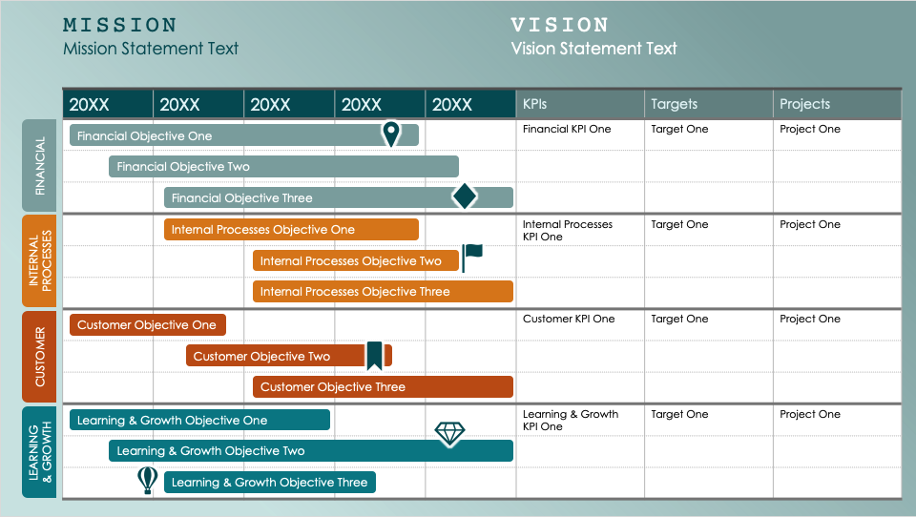
PowerPoint Balanced Scorecard Gantt Template
Organizations and project teams can use this template to merge the strategic oversight of a balanced scorecard with the time-tracking features of a Gantt chart. This template is ideal for visually representing progress on strategic objectives over a multiyear period, illustrating how goals unfold over time from financial, customer, business process, and learning and growth perspectives.

Slide 2






MISSION
VISION
Mission Statement Text
Vision Statement Text
20XX | 20XX | 20XX | 20XX | 20XX | KPIs | Targets | Projects
 |  |  |  |  | Financial KPI One | Target One | Project One
 |  |  |  |  | Internal Processes KPI One | Target One | Project One
 |  |  |  |  | Customer KPI One | Target One | Project One
 |  |  |  |  | Learning & Growth KPI One | Target One | Project One
Financial Objective One
FINANCIAL
Financial Objective Two
Financial Objective Three
Internal Processes Objective One
INTERNAL PROCESSES
Internal Processes Objective Two
Internal Processes Objective Three
Customer Objective One
CUSTOMER
Customer Objective Two
Customer Objective Three
Learning & Growth Objective One
LEARNING
& GROWTH
Learning & Growth Objective Two
Learning & Growth Objective Three

Slide 3
MISSION
VISION
Mission Statement Text
Vision Statement Text
20XX | 20XX | 20XX | 20XX | 20XX | KPIs | Targets | Projects
FINANCIAL
INTERNAL PROCESSES
CUSTOMER
LEARNING
& GROWTH

Slide 4
DISCLAIMER Any articles, templates, or information provided by Smartsheet on the website are for reference only. While we strive to keep the information up to date and correct, we make no representations or warranties of any kind, express or implied, about the completeness, accuracy, reliability, suitability, or availability with respect to the website or the information, articles, templates, or related graphics contained on the website. Any reliance you place on such information is therefore strictly at your own risk.

