Slide 1
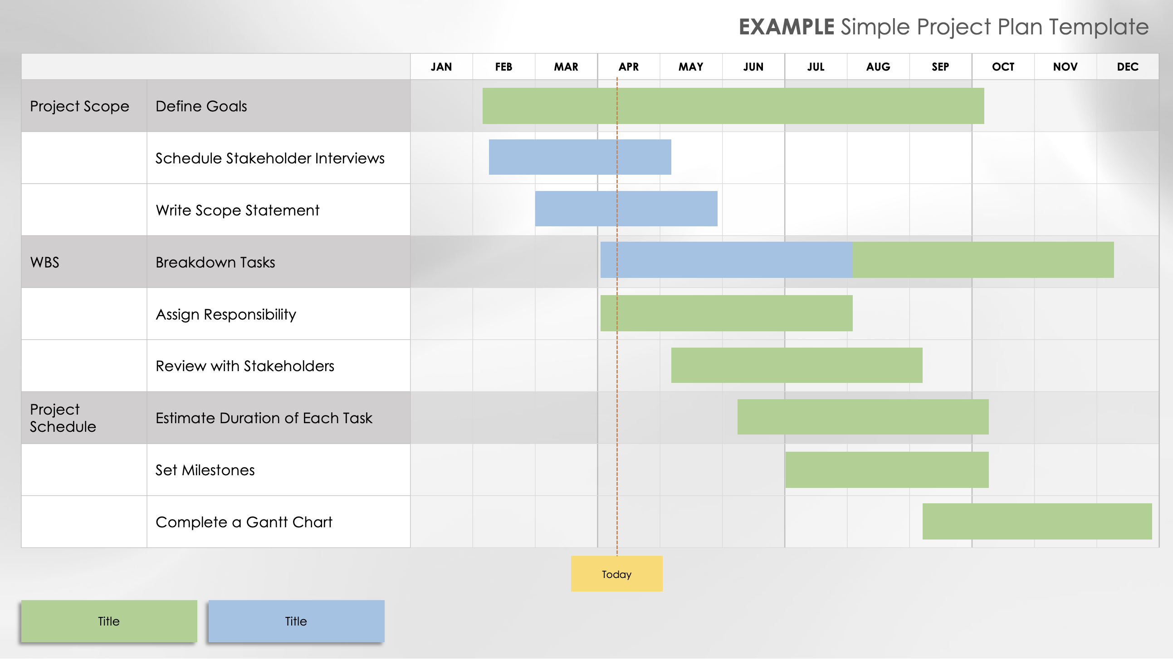
Simple Project Plan Template Example
When to Use This Template: This single-slide template is best suited for project managers who need a simple format for presenting the project deliverables, tasks, and task timelines over one year.
Notable Template Features: This template showcases a straightforward table layout including a horizontal bar chart illustrating each task’s duration. Use the ‘today’ indicator to easily see which tasks are finished, ongoing, or pending. Customize the tasks and timelines to align with your project.

Slide 2
EXAMPLE Simple Project Plan Template
 |  | JAN | FEB | MAR | APR | MAY | JUN | JUL | AUG | SEP | OCT | NOV | DEC
Project Scope | Define Goals
 | Schedule Stakeholder Interviews
 | Write Scope Statement
WBS | Breakdown Tasks
 | Assign Responsibility
 | Review with Stakeholders
Project Schedule | Estimate Duration of Each Task
 | Set Milestones
 | Complete a Gantt Chart
Today
Title
Title

Slide 3
Simple Project Plan Template
 |  | JAN | FEB | MAR | APR | MAY | JUN | JUL | AUG | SEP | OCT | NOV | DEC
Task 1 | Task Description
 | Additional Descriptions
Task 2
Task 3
Today
Title
Title

Slide 4
DISCLAIMER Any articles, templates, or information provided by Smartsheet on the website are for reference only. While we strive to keep the information up to date and correct, we make no representations or warranties of any kind, express or implied, about the completeness, accuracy, reliability, suitability, or availability with respect to the website or the information, articles, templates, or related graphics contained on the website. Any reliance you place on such information is therefore strictly at your own risk.

